Slide 1
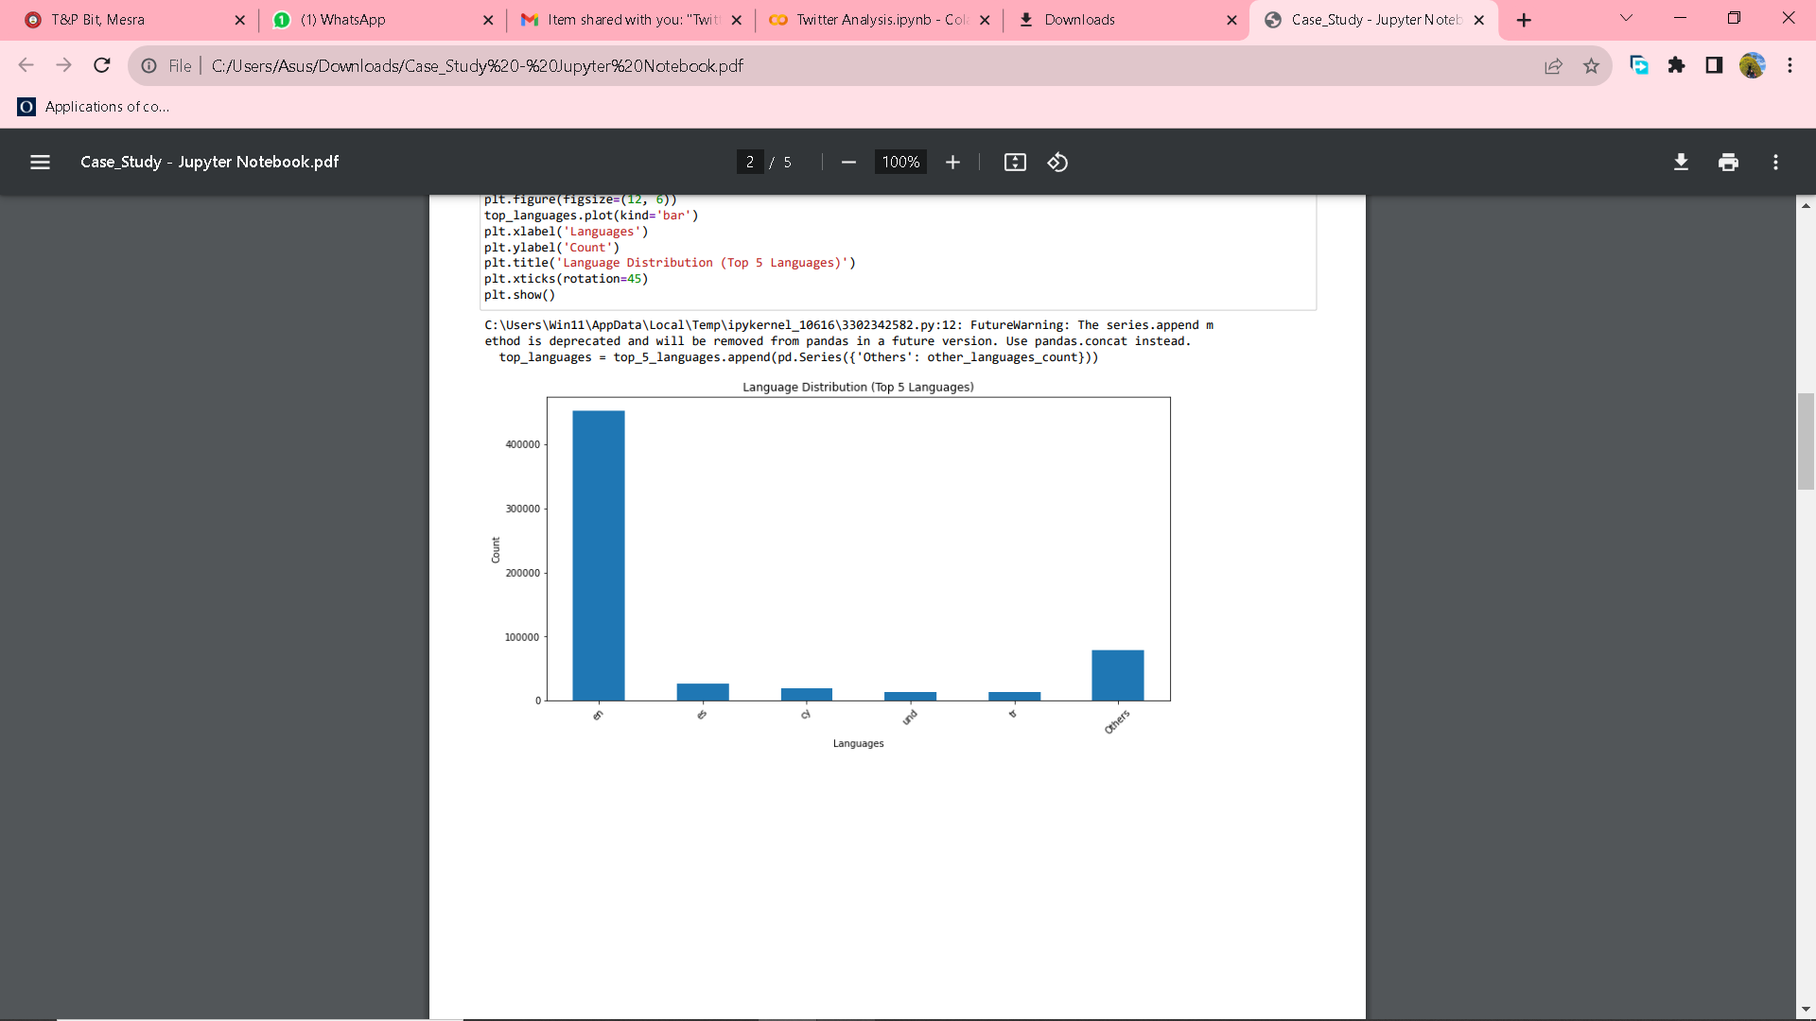
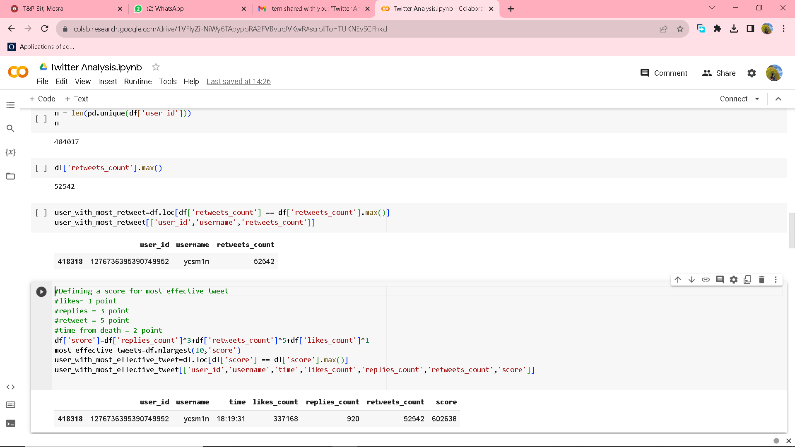
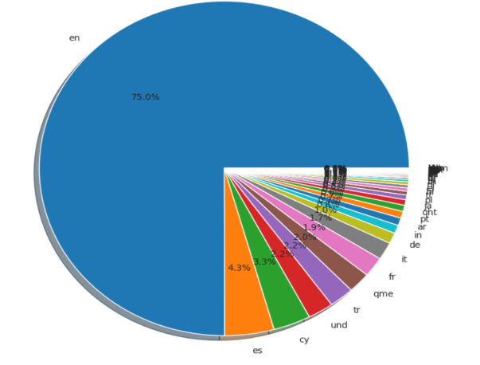
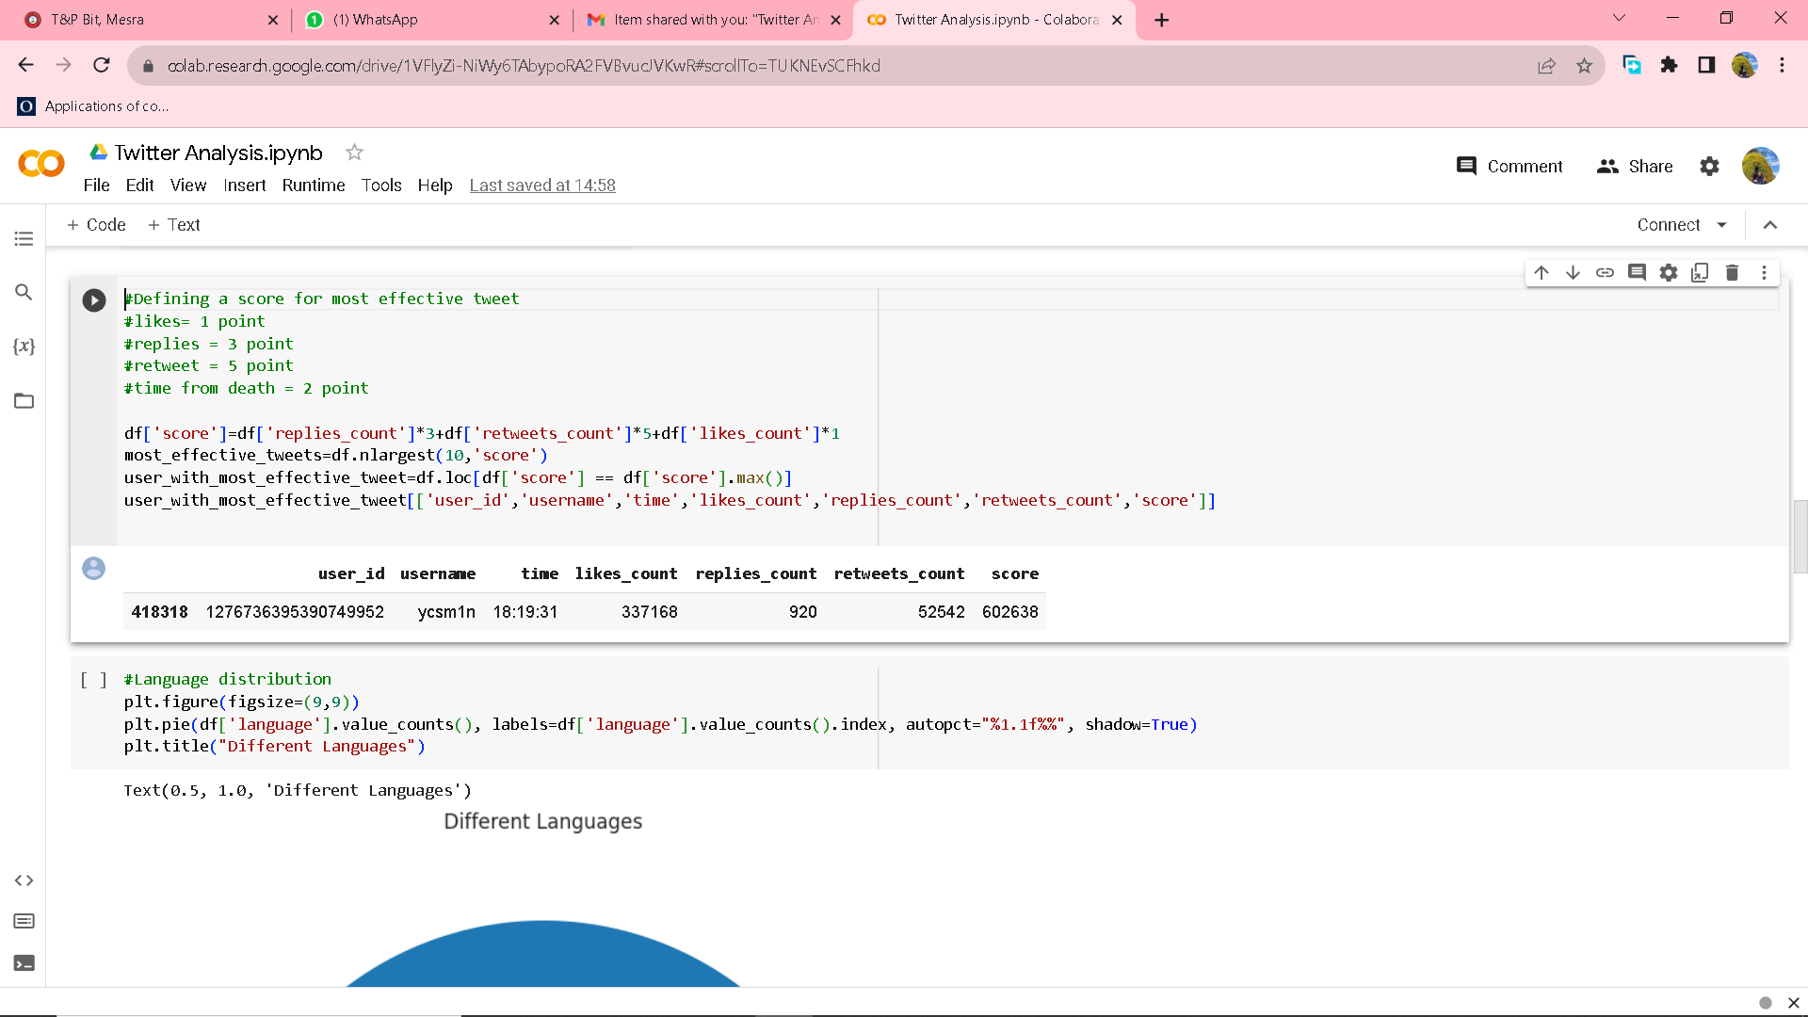
AGENDA
Q1
“ycsm1n” is the user with most number of retweets.
This can be found using .max() function on the “retweets_count” field which gives the highest number of retweets.
Data corresponding to this value can be printed.
Language Distribution
Q3
User with most retweets
Most effective tweet
Language Distribution
Place Distribution
Relationship between likes, retweets and replies
Video makes tweet more likeable?
Defining a score for most effective tweet
#likes= 1 point
#replies = 3 point
#retweet = 5 point
#time from death = 2 point
Tweet_effectiveness = likes + replies*3 + retweet*5 + time from death*2
Using the above formula, the most effective tweet was by “ycsm1n”
Q2
TechStack
The plot shows that most of the tweets are in English(75%) and only 25% of the tweets are in another languages. Seaborn library has been used here and has simply plot the language column.
numpy
pandas
seaborn
matplotlib
geopandas

Slide 2
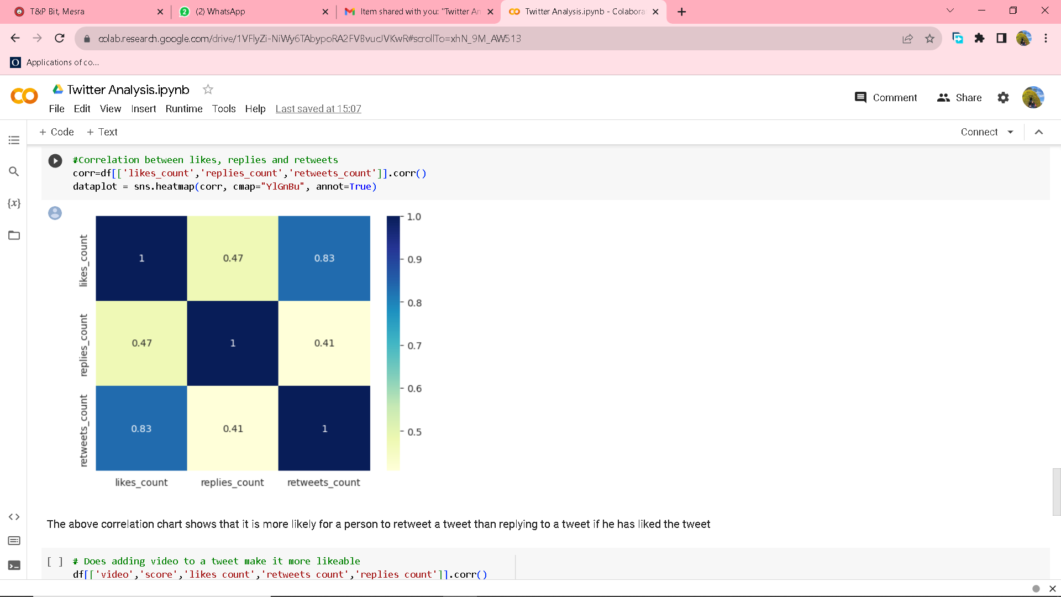
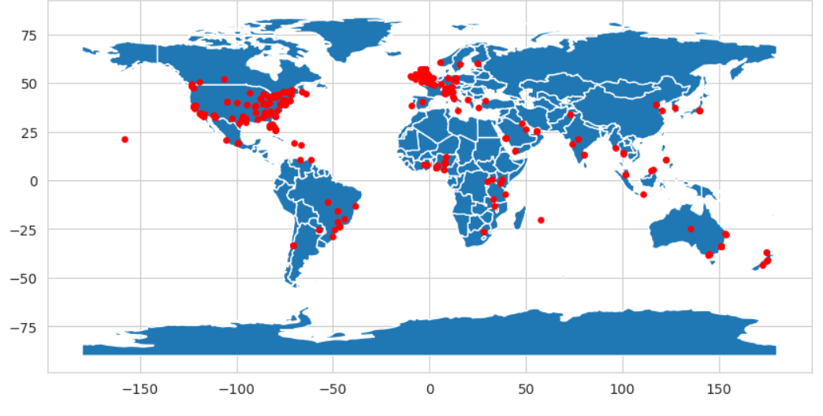
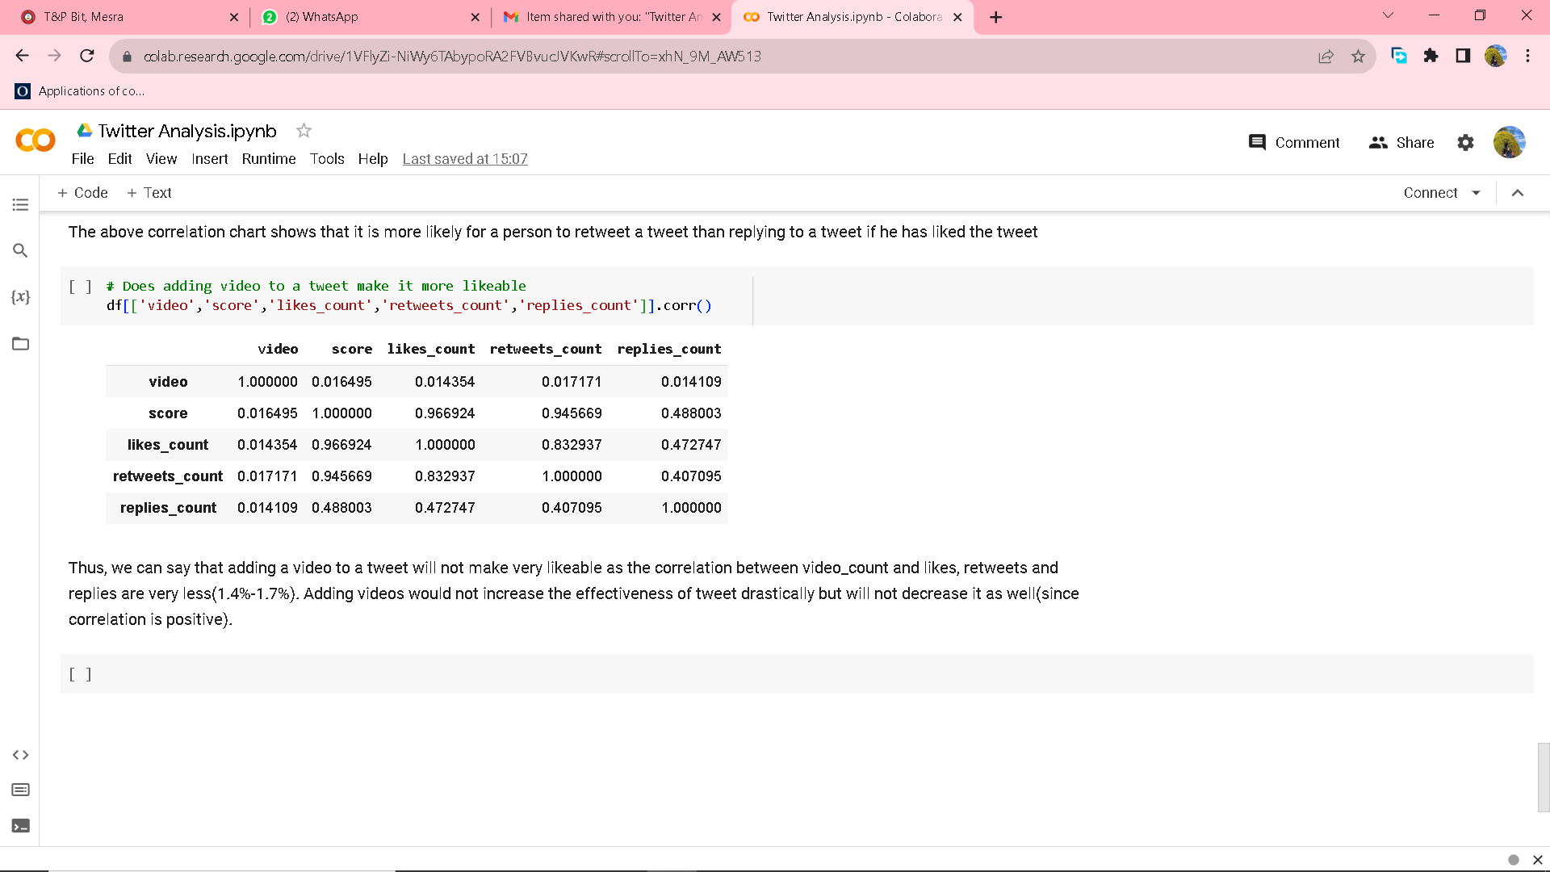
Q3
Q4
The map above shows the visualization for place distribution.
But there were a lot of NULL values so the map has been made omitting those values.
The above correlation chart shows that it is more likely for a person to retweet a tweet than replying to a tweet if he has liked the tweet.
.corr() method has been used to find the Correlation of likes, retweets and replies, value ranging from 0-1. Here 1 is the highest correlation and 0 is no correlation.
Q5
Creating a matrix with the attributes as video, score, like_count, retweets_count and replies_count helps us get aclear picture of the effect of video on tweet making it more likeable or not. The matrix shows that adding a video to a tweet will not make very likeable as the correlation between video_count and likes, retweets and replies are very less(1.4% - 1.7%). Adding videos would not increase the effectiveness of tweet drastically but will not decrease it as well(since the correlation is positive).

